Slide 1



TECH SOLIDERS
S3,EC
RAGHAV PRAKASH
MUHAMMED FAIZ
NABEEL ISHAQ
Notes:
1

Slide 2
INTRODUCTION
This document gives an overview of ventilation systems, their types and importance as well the role they play in managing indoor temperature. Ventilation equipment, which are designed especially for residential or industrial use deliver as such and keep indoor air quality great. Based on needs they can regulate temperature of the room to make it a comfy place. Knowledge about various types of ventilation systems and their working may guide the selection of an ideal system for specific requirements.

Slide 3
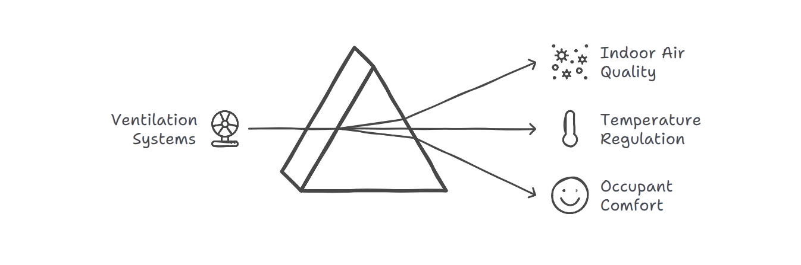

Slide 4
Importance of Ventilation Systems
The main reason ventilation systems are a must have:
1. Improved Air Quality: They absorb indoor pollutants, allergens and excess moisture helping to provide a healthier living or working environment.
2. Temperature regulation: Proper ventilation also helps in maintaining the inside temperature of spaces, rendering them comfortable.
3. Ventilation System Helps In Removing Odor: The ventilation system allows the removal of foul smells that enhances the surroundings of an area.
4. Energy efficiency: Contemporary ventilation systems can be engineered to use a minimum of energy so you would pay less in utility costs but still get the comfort that you need.

Slide 5
VENTILATION SYSTEM
Lack Of Ventilation In Closed Room In 2023,
Bangladesh 13 workers were died due to the lack of oxygen in a plastic factory.

Slide 6
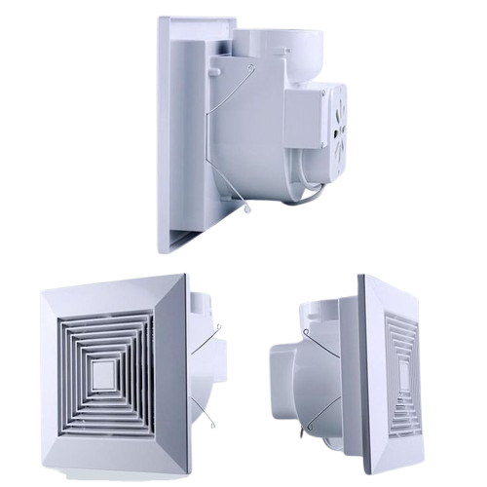
VENTILATING SYSTEM (V.S)
The VS grant you a second life. Better save than Sorry

Slide 7
OBJECTIVES
In a Hall or Labs, in case of sudden foul gases or decrease in oxygen level, even if there is a fire exit, a group of people cannot go out quickly, so our ventilation system works like expell gases inside within minutes.
Improving air quality
Maintaining temperature and humidity

Slide 8
IMPACT AND BENEFITS
Control impurities
Reduce fire incidents
Health benefits
Temperature control

Slide 9
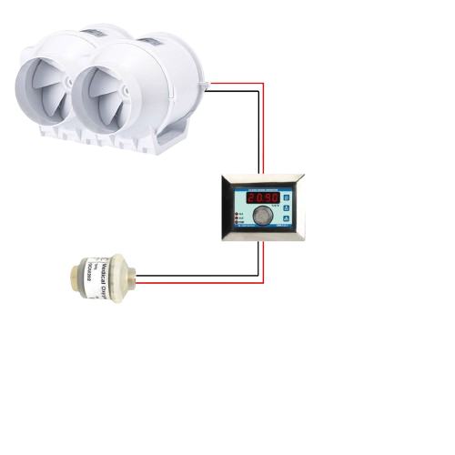
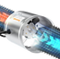
TECHNICAL APPROACH

Slide 10

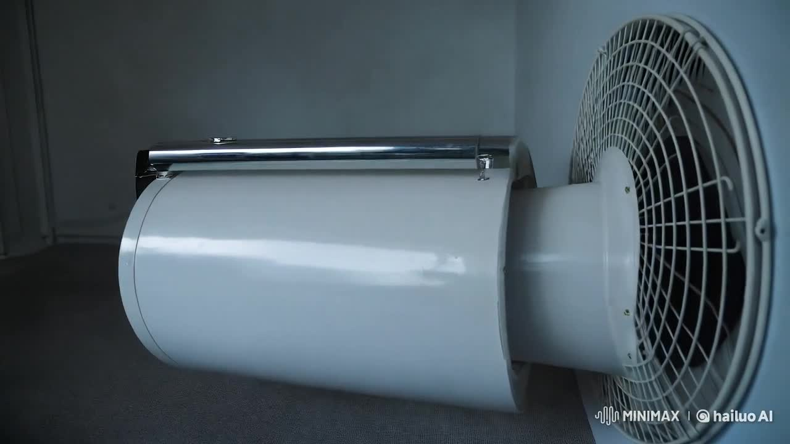
TECHNICAL APPROACH

Slide 11
Conclusion
In conclusion, ventilation systems are vital for ensuring healthy indoor environments. By understanding the different types and components of these systems, individuals and organizations can make informed decisions about their ventilation needs. Properly designed and maintained ventilation systems contribute significantly to comfort, health, and energy efficiency in various settings.

